Slide 1

DATA SCIENCE WITH R
Submitted By:
Mr. Deep Dey

Slide 2
INTRODUCTION TO
DATA AND DATA SCIENCE
Data is distinct pieces of information, usually formatted in a special way. Computer data is information processed or stored by a computer. This information may be in the form of text documents, images, audio clips, software programs, or other types of data.
Data science is the study of data. It involves developing methods of recording, storing, and analyzing data to effectively extract useful information. The goal of data science is to gain insights and knowledge from any type of data — both structured and unstructured.

Slide 3
PURPOSE OF DATA SCIENCE
Data is the new oil for all the industries and data science is the electricity that powers the industry.
Data Science involves the usage of Machine Learning which has enabled industries to create better products tailored specifically for customer experiences.
Data Science deals with enriching data and making it better for their company and analyzing of data also enhance work development and other stuffs.

Slide 4
INTRODUCTION TO R
FOR DATA ANALYSYS
In a basic thought for Data Science we need data for analyzing and manipulation and a language to perform operations on those data. In certain time there are several options with computer languages like R, Python, SQL, java etc. for data analysis. But all of them R, Python are mostly used by Data Scientists. Here we discuss about R.
R is an open-source programming languages with a large community. Academics and statisticians have developed R over two decades. R has now one of the richest ecosystems to perform data analysis. There are around 12000 packages available in CRAN (open-source repository). The rich variety of library makes R the first choice for statistical analysis, especially for specialized analytical work.

Slide 5
FUNCTIONS AND FEATURES OF R
• Load/unload base packages manually
library(datasets)
• View Data sets but only top 6 rows
head(mtcars) #Here mtcars is a data set with 32 entries
• Generic X-Y Plotting
plot(x, y) barplot(x)
X is the coordinates of points in the plot.
Y is the y coordinates of points in the plot, optional if x is an appropriate structure.
• Basic Histograms
hist(x)

Slide 6
FUNCTIONS AND FEATURES OF R
• Summarize the data set
summary(x)
Summarize the Categorical and Quantitative value of x which is an attribute of a Data set.
Min(0%), 1st quartile(25%), 2nd quartile or median(50%), 3rd quartile(75%), mean or average and maximum(100%).
• View of Data sets based on conditions
hist(x[categorical condition])
X is the coordinates of points in the plot.
• Create Sub samples
data[rows, columns]
# Leave rows or columns blank to select all
Variable<-data_set(sub-sample conditions)

Slide 7
DATA TYPES IN R
• Numeric
n1 <- 15 # Double precision by default
n1 # Output of the value of n1
typeof(n1) # Data type of n1
• Character
c1 <- “D” # For single character
c2 <- “Deep” # For a string
• Logical
L1 <- TRUE #Signify a Logical state
L2 <- F

Slide 8
DATA STRUCTURES IN R
• Vector
v1 <- c(1, 2, 3, 4, 5) #c(x, y,…) is an function
#c defines concatenate/combine
• Matrix
m1 <- matrix(c(T, T, F, F, T, F), nrow = 2) #Default
m2 <- matrix(c("a", "b", #To store row wise
"c", "d"),
nrow = 2,
byrow = T)
• Array
a1 <- array(c( 1:12), c(4, 3, 1))
# Give data, then dimensions (rows, columns, tables)

Slide 9
ENTERING DATA IN R
• Single value assign
x1 <- 10 #Assign a single value
• Assign value in an order
x2 <- 0:10 #Ascending order
x3 <- 10:0 #Descending order
• A sequence of value assign
x4 <- seq(30, 0, by = -3)
x5 <- seq(0, 30, by = 3)
• Using scan function
x6 <- scan() #Can take input from user
• Using repeat function
x6 <- rep(x6, 5) #Repeat the data of x6 for 5 times

Slide 10
IMPORTING DATA IN R
TYPES
#To import data in R we use a package called rio. It combines all R’s import functions into one simple utility.
variable1 <- import(path of the file) #Can import any of those files
view(variable1) #Show the whole Data set
CSV
(Common
Separetd
Value)
TXT
XLSX
JSON
(JAVA
Script
Object
Notation)

Slide 11
MODELING DATA
HIERARCHICAL CLUSTERING
Observation on which cases of data is similar with each other.
In simple word, which cases are like with like other one. But similarities depend on criteria.
# Save hierarchical clustering to “hc”. This codes uses
pipes from dplyr.
hc <- cars %>% # Get cars data
dist %>% # Compute distance/dissimilarity matrix
hclust # Computer hierarchical clusters
# ‘ %>%’ took the result of one step and feed it directly to the next level

Slide 12

MODELING DATA
PRINCIPAL COMPONENTS
Less noise and fewer unhelpful variables in data can make more meaning./Dimensionality Reduction.

Slide 13
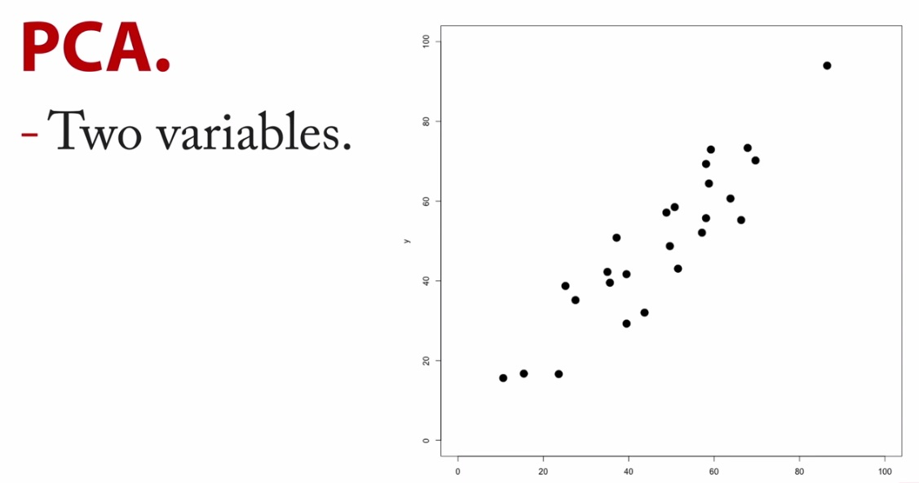
MODELING DATA
PRINCIPAL COMPONENTS ANALYSIS(PCA)

Slide 14
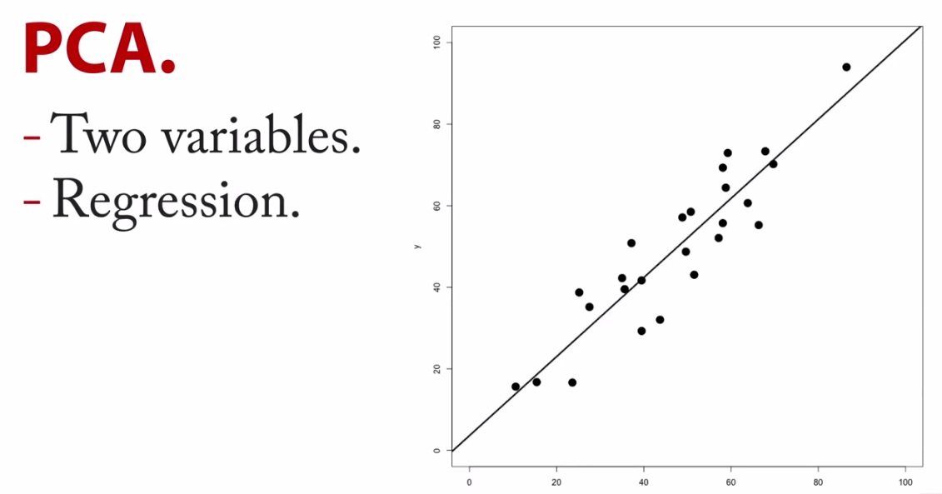
MODELING DATA
PRINCIPAL COMPONENTS ANALYSIS(PCA)

Slide 15
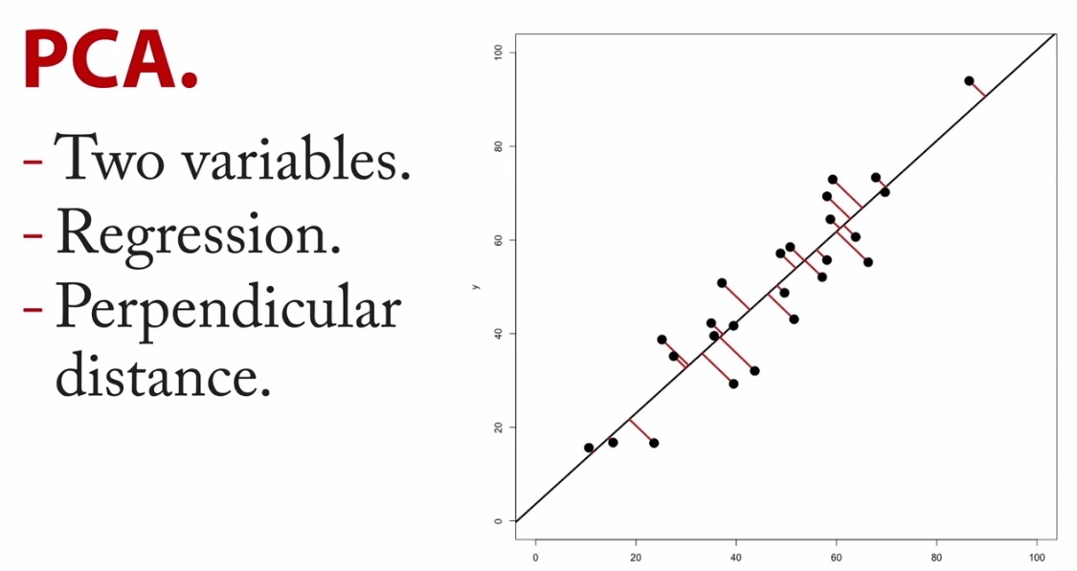
MODELING DATA
PRINCIPAL COMPONENTS ANALYSIS(PCA)

Slide 16
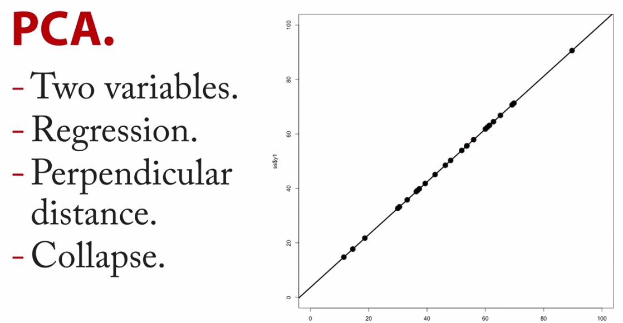
MODELING DATA
PRINCIPAL COMPONENTS ANALYSIS(PCA)

Slide 17
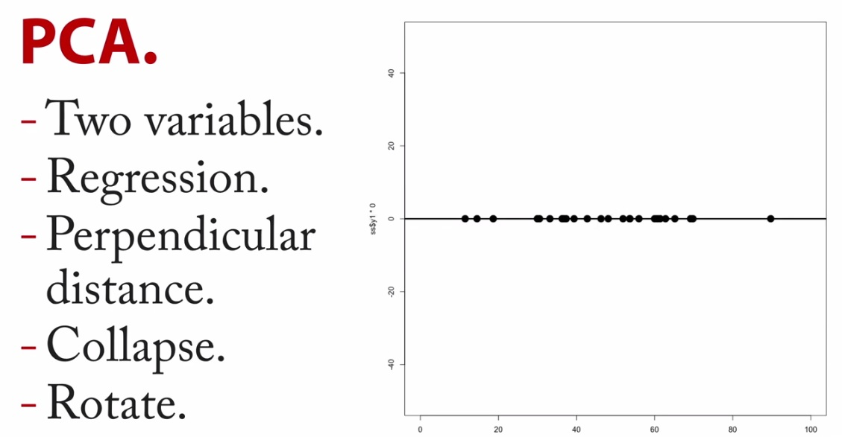
MODELING DATA
PRINCIPAL COMPONENTS ANALYSIS(PCA)

Slide 18
MODELING DATA
SIMPLE LINEAR REGRESSION
•Use many variables to predict the score of one variable.
•It is a Statistical tool to find relation between two variables(x,y).
One variable is the predictor and the other is the response.
•To find the linear regression we use a function lm()
lm(formula,data)
Formula is relation between x and y.
And the formula will apply on data.

Slide 19
THANK YOU

